Slide 1


Chapter 10
Using a relational database server for sharing and storing information

Slide 2
Learning objectives
1. What are relational databases
2. How to create tables in a relational database
3. How to insert/delete/update records in a relational table
4. How to connect to a relational database server using node.js
5. How to manipulate relational database using node.js

Slide 3
Relational databases
Database model: defines the structure and operations that will be performed on a database.
Relational database

Slide 4
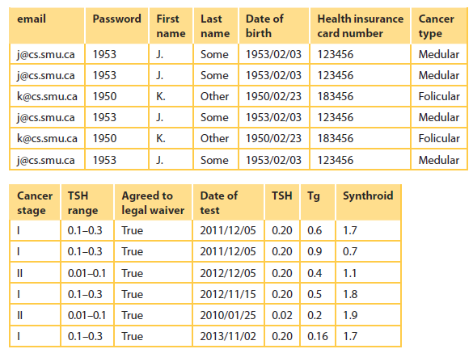
Modeling a relational database
The table consists of fourteen attributes/columns
There is a row/record for each blood test completed for the patients.

Slide 5
SQL
Structured Query Language (SQL)
Used for manipulation and retrieval of data in the relational database world.
Various categories
Definition: For managing the structure of the database
Retrieval: Most frequently used function to extract data from the database
Manipulation: Adding, deleting or modifying data in the database
Control: To manage access to the database
Graphical user interface (GUI) and command line interface (CLI).
MySQL

Slide 6
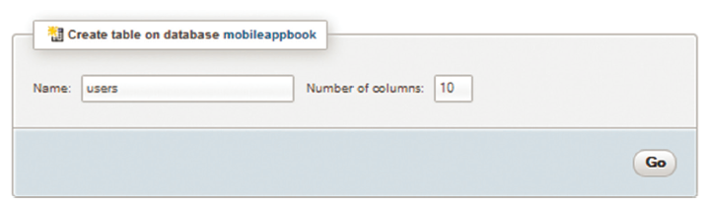
Creating the User table using phpMyAdmin

Slide 7
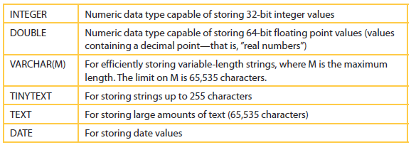
Common data types in SQL
A more detailed list can be found at www.mysql.com.

Slide 8
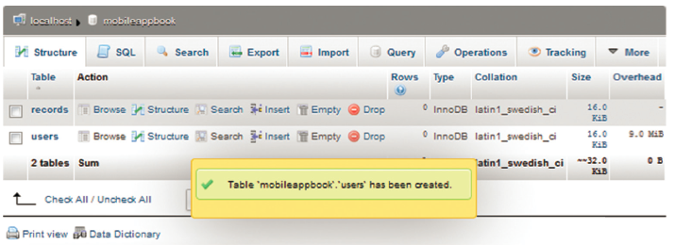
Results of creating the User table using phpMyAdmin
The complete structure of the table is shown below.
Describes the primary and unique keys as well as other indexed attributes.
The figure also shows the query in SQL that was used to create the table.

Slide 9
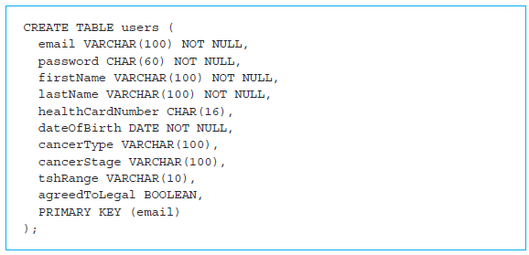
SQL command for creating the User table
CREATE command.

Slide 10
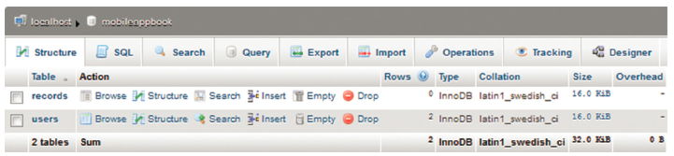
Add one more table to store our Records consisting of the following attributes
1. User (email address)
2. Date of test
3. TSH
4. Tg
5. Synthroid

Slide 11
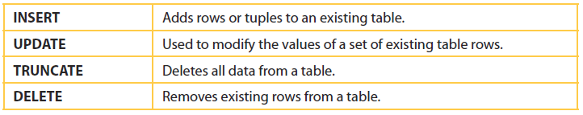
Data manipulation SQL commands

Slide 12
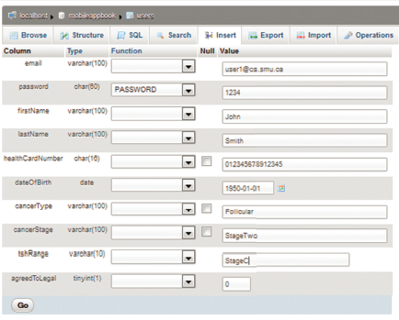
Insertion of a record in the Records table from our database
Insertion of a record in the Records table from our database using the phpMyAdmin interface.

Slide 13
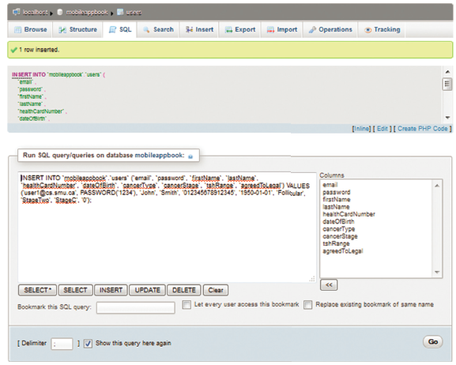
Results of inserting records using phpMyAdmin
The INSERT command can be used to insert a large number of records in our database even from a text file in comma separated value (CSV) format.
LOAD DATA: another SQL command

Slide 14
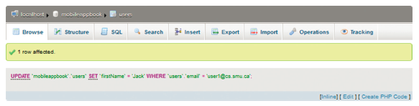
update operation along with the SQL UPDATE command
The general format of the UPDATE operation:
UPDATE table_reference
SET col_name1=value
col_name2=value ...
WHERE where_condition
ORDER BY ...
LIMIT row_count

Slide 15
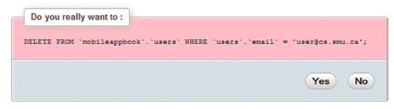

SQL DELETE command
DELETE FROM table_reference
WHERE where_condition
ORDER BY ...
LIMIT row_count

Slide 16
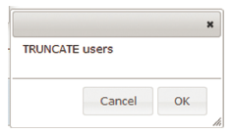
Emptying a table using phpMyAdmin
The DELETE command can also be used for deleting multiple records by stating an appropriate condition in the WHERE clause.
TRUNCATE command:
empty the entire table
can be invoked by clicking on the fifth icon next to the table name

Slide 17
SELECT command
The records are retrieved from a database using a SELECT statement.
In a SELECT query, the user only describes the desired result set.
Commonly used keywords with a SELECT command:
FROM indicates from which tables the data is to be taken.
WHERE specifies which rows are to be retrieved.
GROUP BY is used to combine rows with related values.
HAVING acts much like a WHERE, but it operates on the results of the GROUP BY.
ORDER BY is used to identify which columns are used to sort the resulting data.

Slide 18
SELECT command (cont’d)
MySQL commands can also work from your UNIX/Linux command line by typing:
mysql -u username -p
Type the USE command to change to the database.
Use the SHOW TABLES command to get the list of the tables in the database.
Couple of simple executions of the SELECT command
SELECT * FROM records;

Slide 19
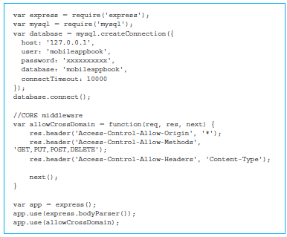
Launching the MySQL server for the Thyroid app
The database server of the MySQL-based Thyroid app is launched with the command node server.js.
File contains all of our database server program that will handle all the requests.

Slide 20
Launching the MySQL server for the Thyroid app (cont’d)
Express is required on the database server to handle POST and GET requests from the browser.
The mysql module will help us communicate with the mysql server.
Create an object called database that is created using the call to the method mysql.createConnection().
The method receives a JSON object with the following fields:
host
user
password
database
connectTimeout

Slide 21
Saving a new user on the MySQL server for the Thyroid app
app.post() method receives two parameters:
request ‘/saveNewUser’ that will be handled by the server
anonymous function that contains the rest of the code
Create an SQL INSERT query using the method database.query()

Slide 22
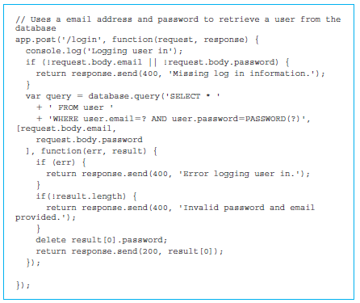
Processing login with the MySQL server for the Thyroid app
Code for processing login request is shown below
app.post() method receives two parameters:
request ‘/login’ that will be handled by the server
anonymous function that contains the rest of the code
The request that is received by the post() method and the response that will be returned.

Slide 23
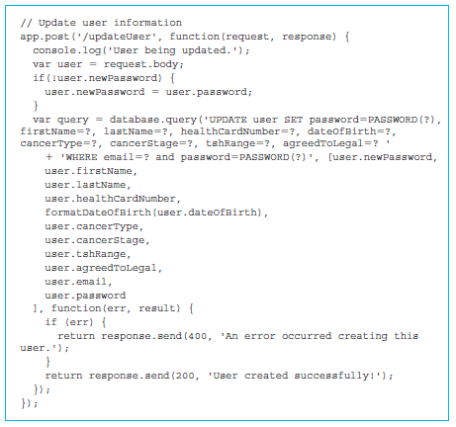
Updating user data in the MySQL server for the Thyroid app
The code for processing updateUser request
method app.post()

Slide 24
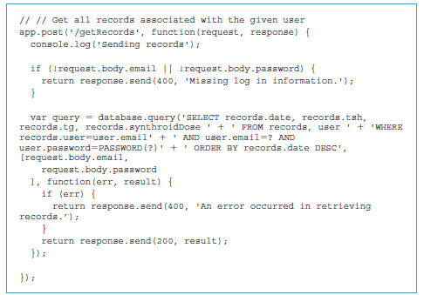
Downloading records from the MySQL server for the Thyroid app
getRecords request

Slide 25
Uploading records to the MySQL server for the Thyroid app
Processing a syncRecords request
app.post() method receives two parameters:
request ‘/syncRecords’ that will be handled by the server
the anonymous function that contains the rest of the code
The request that is received by the post() method and the response that will be returned.
Delete all the existing records for the user using the method database.query().
Add the new records received through the array recordsToSave
Create an SQL INSERT query using the method database.query().

Slide 26
Quick facts/buzzwords
Relational database model
MySQL
mysql
use
show tables
describe
INSERT
UPDATE
DELETE
SELECT
TRUNCATE
DROP
CORS

